Slide 1
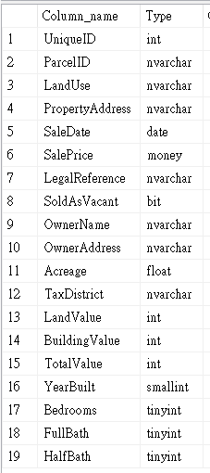
Dataset Description
Nashville Housing ETL Project
SQL ETL + Power BI Visualization
<< Table Schema
This dataset contains information about housing sales in Nashville, TN.
Size: 56,478 rows / 19 columns
Source: https://www.kaggle.com/datasets/bvanntruong/housing-sql-project/data
陳逸 Rachel Chen

Slide 2
Question Design
Goal
Clean and transform the Nashville housing data to prepare it for further analysis.
Visualize the data to simplify understanding and highlight trends in property sales by year and location.
>> Columns Used: UniqueID, LandUse, PropertyAddress, SaleDate, SalePrice, Acreage, LandValue, BuildingValue, TotalValue
Tools used in this project
Programming Language: SQL
ETL Process: Extract → Transform → Load
Visual: Power BI

Slide 3
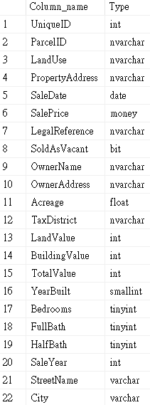
ETL Process
Table Schema >>
(after transformation)
Extract
Imported data into MS SQL database.
Transform
Cleaned Data
-- Changes SaleDate to a standard DATE format
-- Adds a new column SaleYear
-- Splits PropertyAddress into StreetName and City
-- Adds new columns for StreetName and City
-- Removes NULL values from the PropertyAddress column
Size after transformation: 56,478 rows / 22 columns
Load
Loaded data into Power BI and executed visualizations.

Slide 4
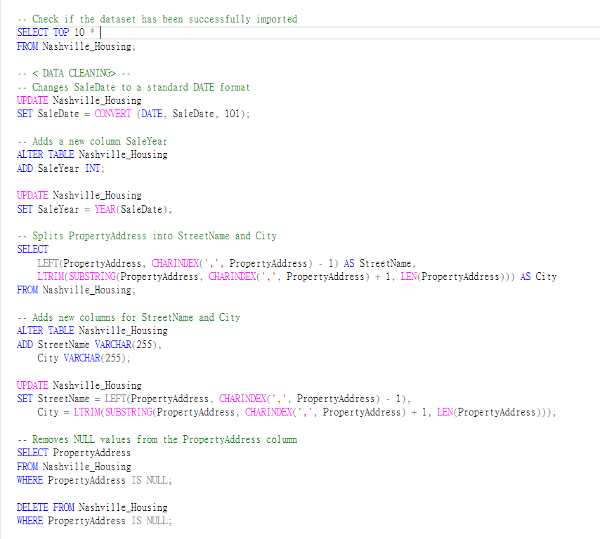
Code (MS SQL)

Slide 5
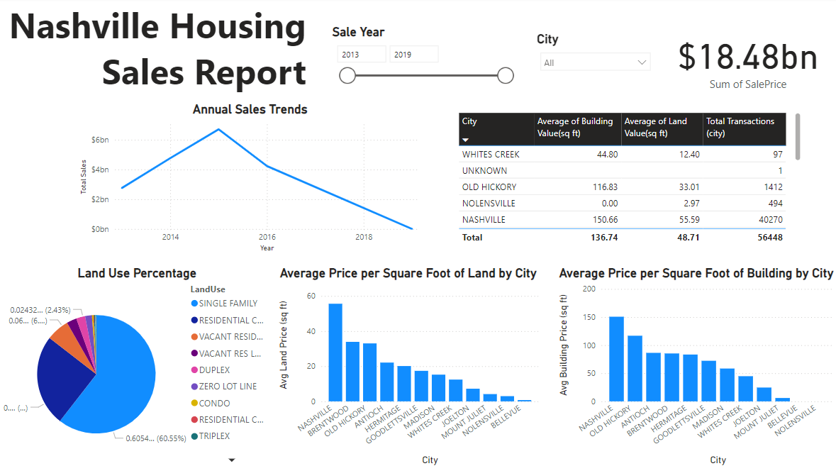
Visualization
Description
Slicer:
Sales Year and City
Annual Sales Trend:
Utilized a line chart to display the sales trend from 2013 to 2019.
Land Use Percentage:
Showed the overall land use distribution, with land use classified by city using a pie chart.
Average Price of Land (Building)
by City (per square foot):
Used column charts to compare the average land (building) price across different cities.
Table:
Displayed the overall information in a table format.

Slide 6
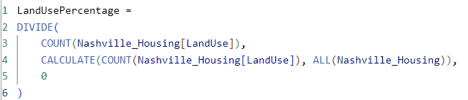
DAX (Power BI)

